Slide 1

Lab of Plotters | Group 1 Plotters Against Cancer
CU-VIRT-AI-PT-0602024-U-LOLC-MWTH | DATA ANALYSIS, PROJECT 1

Slide 2




Lab of Plotters Team 1
Kala Sivasubramanian
Data Strategy Architect & Insights Alchemist… and Project Lead
Albert Hernandez
Data Ecosystem Innovator
& Analytics Luminary
The Team
Jordan Kesner
Metric Harmonization Engineer & Data Sculptor
Yifei Li
Big Data Illuminator & Synergistic Metrics Curator
Jonathan Schwartz
Empirical Data Scribe & Narrative Weaver
Frederik Tylim
Holistic Information Synthesis Illuminator
Notes:
Presenter: Frederik Tylim

Slide 3
The Question
How are cancer incidence – diagnosis and mortality from the disease - related to demographic and socioeconomic factors?
Race
Age
Gender
Education Level
Income Level
Insurance Coverage
Clinical Trials per Capita

Slide 4
Project Overview
Overview of the data collection, cleanup and exploration processes
The approach your group took in achieving project goals

Slide 5
Project Proposal (High Level / One Sentence)
X
Each question in the project proposal is answered with precise descriptions and findings
Each question response is supported with a well-discerned statistical analysis from lessons, such as aggregation, correlation, comparison, summary statistics, sentiment analysis, and time series analysis

Slide 6
Project Details
Repository Name
Project URL
Organization of Repository
Commit Message Example(s)
Number of commits to repository
Additional Context from GitHub README

Slide 7
Methodology and Data Sources Used

Slide 8
Analysis (High Level)

Slide 9

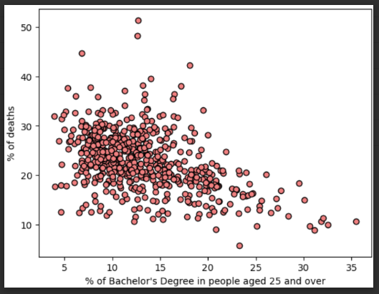
Is There a Relationship Between Cancer Incidence and/or Death Rates with Education Level?
KALA 1
Question
The average number of cancer cases has an extremely weak negative correlation with higher education:
The columns "Some College 18-24 %", "Bachelor’s Degree 18-24 %" and "Bachelor’s Degree 25 and Over %" all show negative correlations to cancer incidence rates, though they are extremely weak correlations.
The average number of deaths has a moderate negative correlation (-0.448336) with "Bachelor’s Degree 25 and Over %" and a moderate positive correlation (0.487745) with "High School 25 and Over %".
Analysis
Populations that have a greater percentage of people over 25 with a Bachelor’s Degree will see lower percentage of cancer deaths. The reverse is also moderately true. Populations that have a greater percentage of people over 25 with only a high school degree experience a higher percentage of cancer deaths.
Conclusions
Notes:
Presenter: Kala

Slide 10
Visualization and Analysis 2
KALA 2
Question
Analysis
Clear and accurate labeling of images
Visualizations supported with ample and precise explanation
Conclusions
Notes:
Presenter: Kala

Slide 11
Visualization and Analysis 3
ALBERT 1
Question
Analysis
Clear and accurate labeling of images
Visualizations supported with ample and precise explanation
Conclusions
Notes:
Presenter: Albert

Slide 12
Visualization and Analysis 4
ALBERT 2
Question
Analysis
Clear and accurate labeling of images
Visualizations supported with ample and precise explanation
Conclusions
Notes:
Presenter: Albert

Slide 13
Visualization and Analysis 7
Jordan 1
Question
Analysis
Clear and accurate labeling of images
Visualizations supported with ample and precise explanation
Conclusions
Notes:
Presenter: Jordan

Slide 14
Visualization and Analysis 8
Jordan 2
Question
Analysis
Clear and accurate labeling of images
Visualizations supported with ample and precise explanation
Conclusions
Notes:
Presenter: Jordan

Slide 15
Visualization and Analysis 5
Yifei 1
Question
Analysis
Clear and accurate labeling of images
Visualizations supported with ample and precise explanation
Conclusions
Notes:
Presenter: Yifei

Slide 16
Visualization and Analysis
Yifei 2
Question
Analysis
Clear and accurate labeling of images
Visualizations supported with ample and precise explanation
Conclusions
Notes:
Presenter: Yifei

Slide 17
Summary of the Data
Findings are strongly supported with numbers and visualizations
Write-up summarizes major findings and implications at a professional level
Each question in the project proposal is answered with precise descriptions and findings
Each question response is supported with a well-discerned statistical analysis from lessons, such as aggregation, correlation, comparison, summary statistics, sentiment analysis, and time series analysis
All eight inquiries into the data are telling the same story that poverty is the most likely root cause predictor of cancer incidence
Notes:
Presenter: Jonathan

Slide 18
Additional
Any additional questions that surfaced, what your group might research next if more time was available, or share a plan for future development
Issues with the data:
Data population sizes imbalanced
Data not collected with the same definition state to state
Categories e.g. “Asian” as a category is very broad and not particularly descriptive
Notes:
Presenter: Jonathan

Slide 19
In closing…
Findings are strongly supported with numbers and visualizations (10 points)
Write-up summarizes major findings and implications at a professional level
Notes:
Presenter: Kala

Slide 20
Kala
My project purpose: I am looking at the relationships between cancer rates and death rates to education and income across all states and counties in the US
the questions I am trying to answer are:
Are cancer incidence and death rates greater when % of people living in poverty is higher, or median income is lower?
Are cancer incidence and death rates higher or lower for people employed versus unemployed?
Any relationship between cancer incidence and death rates to educational level?
My response to Qt #3: ## Q: Is there a relationship between cancer incidence and death rates AND educational level? 1. The average number of cancer cases have an extremely weak negative correlation with higher education. For example, the 3 columns "Some College 18-24 %", "Bachelor Degree 18-24 %" and "Bachelor Degree 25 and Over %" all show a negative correlation to cancer incidence rate, though they are extremely weak correlations.1. The average number of deaths has a moderate negative correlation (-0.448336) with "Bachelor Degree 25 and Over %" and a moderate positive correlation (0.487745) with "High School 25 and Over %". ### Conclusions: * Populations that have a greater percentage of people over 25 with a Bachelor's degree will see lower percentage of cancer deaths. The reverse is also moderately true. Populations that have a greater percentage of people over 25 with only a high school degree will see higher percentage of cancer deaths.

